Slide 1



Name of Project
Air Quality Index Prediction Model with Python
NAME – BHAWANAND JHA
Internship ID : INTERNSHIP_1736246007677d02f700dbe

Slide 2

Learning Objectives
In this week, we have learnt how to read our data from a CSV file by using Python language & doing some mathematical operations by using Python to find rows and columns, addition, subtraction, multiplication, etc.
GOAL
Source :
www.freepik.com/

Slide 3
Tools and Technology used
In this internship, we have to use Python for our coding purpose related to AI with Green Technology.
I have used Visual Studio Code to implement my program. In Visual Studio Code, we first have to set up some features for using Python.
So the features I have to install in my VS CODE for using python are:-
• Seaborn Package
• Pandas
• Numpy
• Matplotlib
• Jupyter Notebook
• Pip packages

Slide 4
Methodology
The Method of doing code in Python is given below step by step (Only for VS CODE) :-
First, we have to download all the necessary packages, which is given in the previous Slide.
2. After downloading all the necessary packages, we have to simply write Jupyter Notebook in the Terminal of the VS CODE.
After writing Jupyter Notebook, It will take you to the chrome page of your default browser.
That chrome page will be the Jupyter Notebook where we have to do our code.
First, we have to make a separate folder where whatever the code we will do regarding this internship will be saved there.
So, these are the methodologies for doing code in this internship.

Slide 5
Problem Statement:
We have to find data of 100 cities from the CSV file known as Air Quality Index.

Slide 6
Solution:
import numpy as np
import pandas as pd
import matplotlib.pyplot as plt
from warning import filterwarnings
filterwarnings('ignore’)
df = pd.read_csv('air quality data.csv.csv’)
df.head(100)

Slide 7
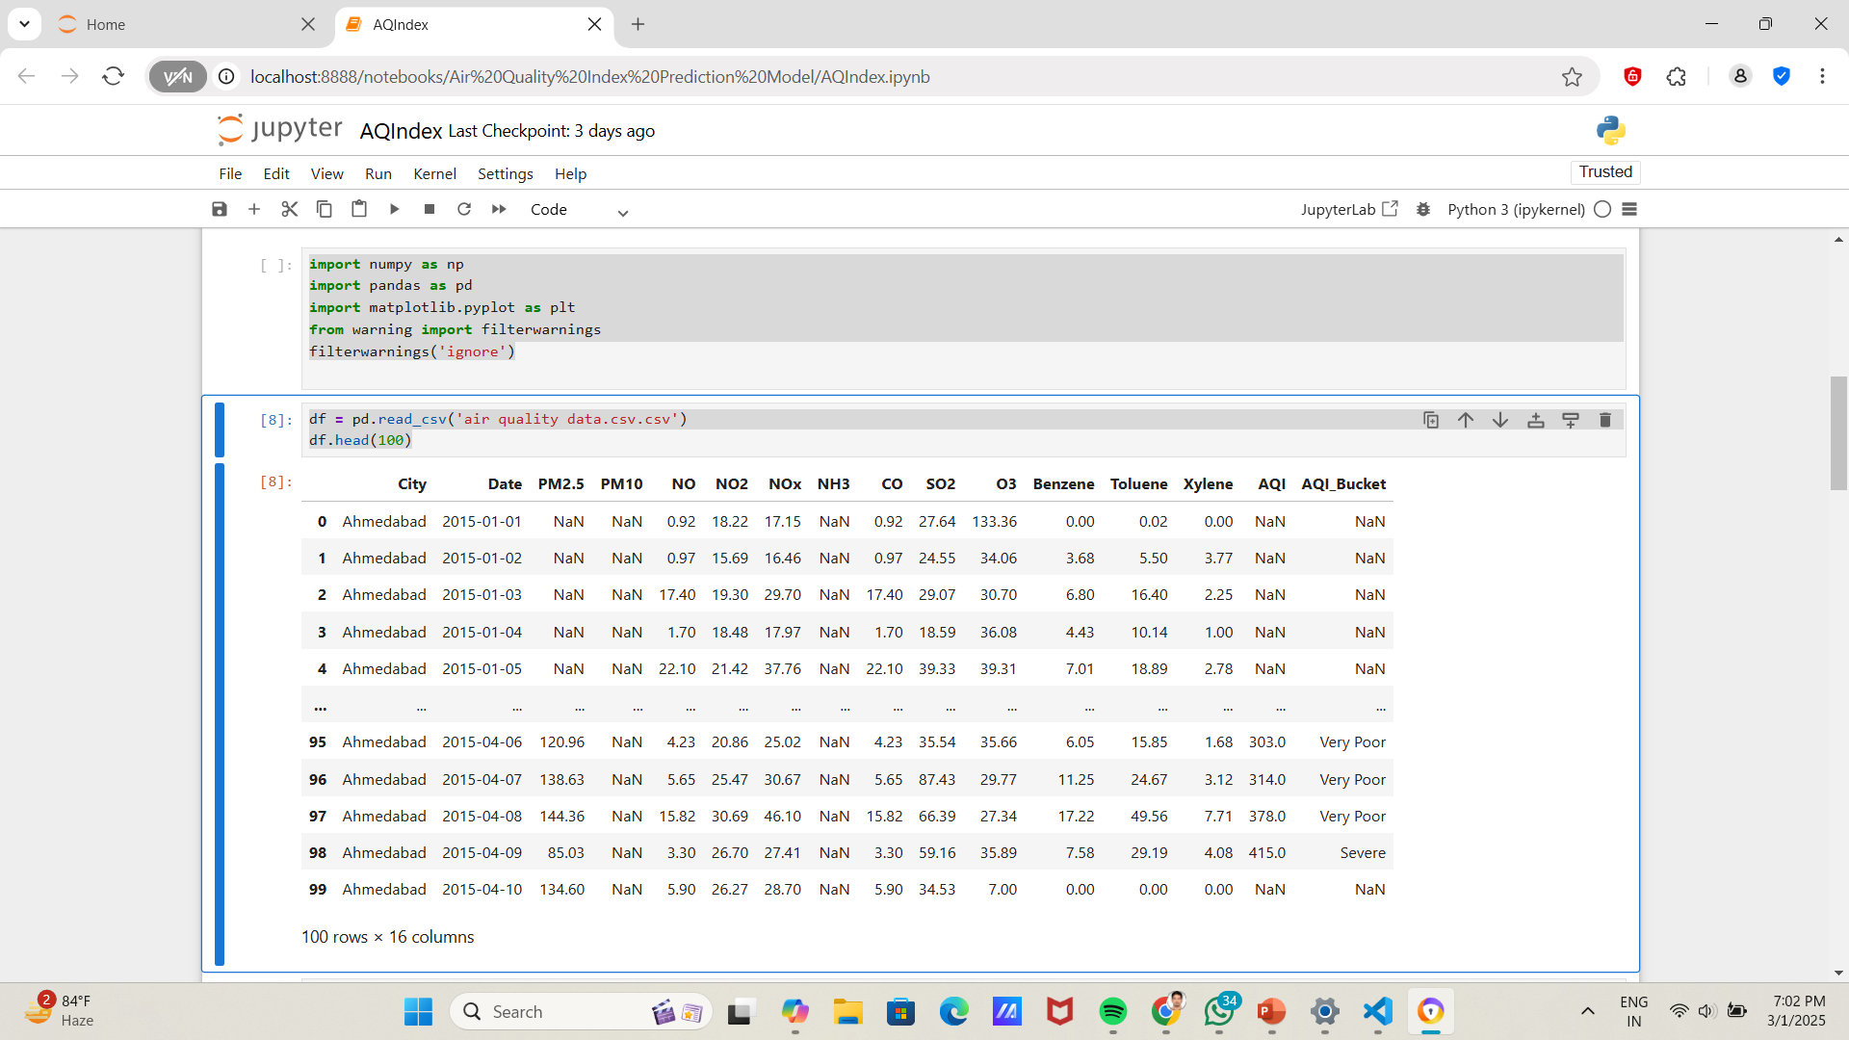
Screenshot of Output:

Slide 8
Conclusion:
So this week, we have seen how to implement Python in VS CODE and read the CSV files using Python.

